Slide 1
Phenols
Dr Amit Kumar Yadav
Assistant Professor-Chemistry
Mahamaya Government Degree College, Mahona, Lucknow (U.P.)

Slide 2
Phenols contain the hydroxyl group(s) linked directly to the aromatic nucleus
Word Phenol originated from phenyl+enol
In contrast to simple ketones which are more stable than their corresponding enols
Analogous equilibrium for phenol lies more on the enol side, due to high resonance energy of aromatic ring that stabilises enol (phenol) form

Slide 3
Classification and nomenclature
Monohydric phenols
Dihydric phenols
Trihydric phenols

Slide 4
Preparation
From aryl sulphonic acids
From diazonium salts

Slide 5
Hydrolysis of aryl halides
Dakin Reaction

Slide 6
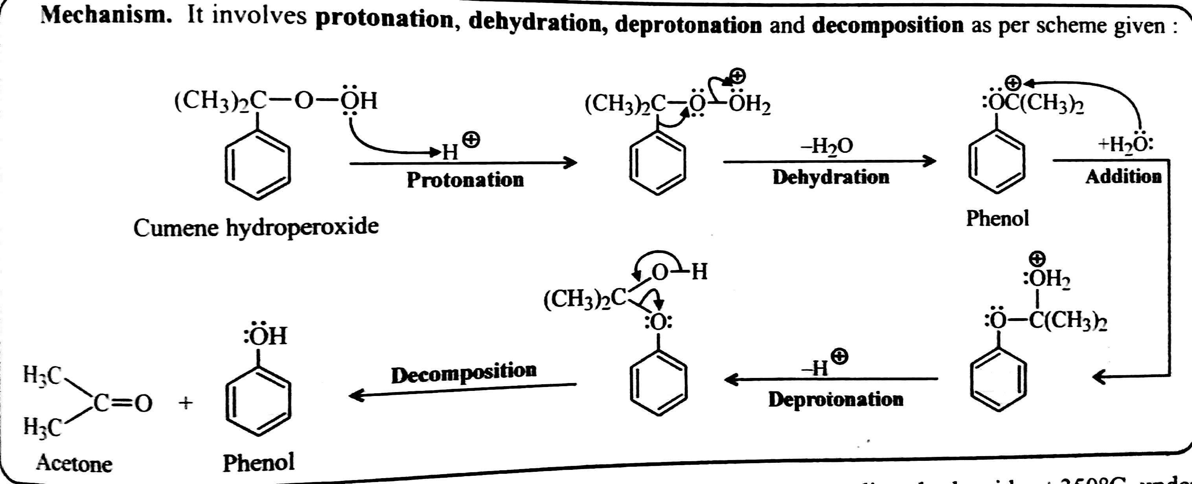
From Cumene hydroperoxide (commercial method)

Slide 7
General physical properties
Pure phenols are generally colourless solids or liquids, but they turn reddish due to atmospheric oxidation
Phenols insoluble in water but di- and tri-hydric are fairly soluble
High B.P. due to intermolecular hydrogen bonding

Slide 8
General chemical properties
Acidic character of phenols-
They are fairly acidic compounds which form salts (phenoxides) on reaction with alkali metal hydroxides, but not with carbonates or bicarbonates

Slide 9
Acidic strength of phenols-
Simple phenols have pKa of the order of 10
It is thus evident that phenols are much more acidic than alcohols but less than carboxylic acids or even carbonic acid
Electron-withdrawing substituents (e.g.-NO2, -Cl etc.) enhance the acidic character, but
Electron-releasing substituents (e.g.Alkyl gps.) decrease the acidic character

Slide 10
A. Reactions of –OH group similar to Alcohols
With metallic sodium
Esterification
Fries Rearrangement

Slide 11
Etherification (Williamson synthesis of ethers)
Claisen rearrangement-

Slide 12
B. Electrophilic aromatic substitution reactions
Halogenation
Nitration
Sulphonation

Slide 13
Friedel-Craft alkylation and acylation
Coupling with diazonium salts
Reimer-Tiemann Reaction

Slide 14
Kolbe-Schmidt reaction
Nitrosation
Reaction with formaldehyde

Slide 15
Gatterman synthesis
Houben-Hoesch reaction
Mercuration
Oxidation

Slide 16
Thanks

